Slide 1
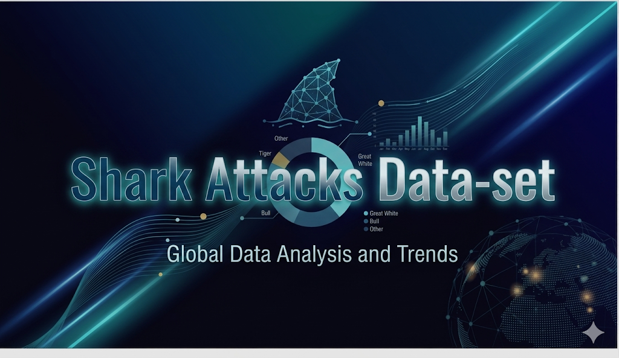



GROUP 5 BSDS
Notes:
2

Slide 2

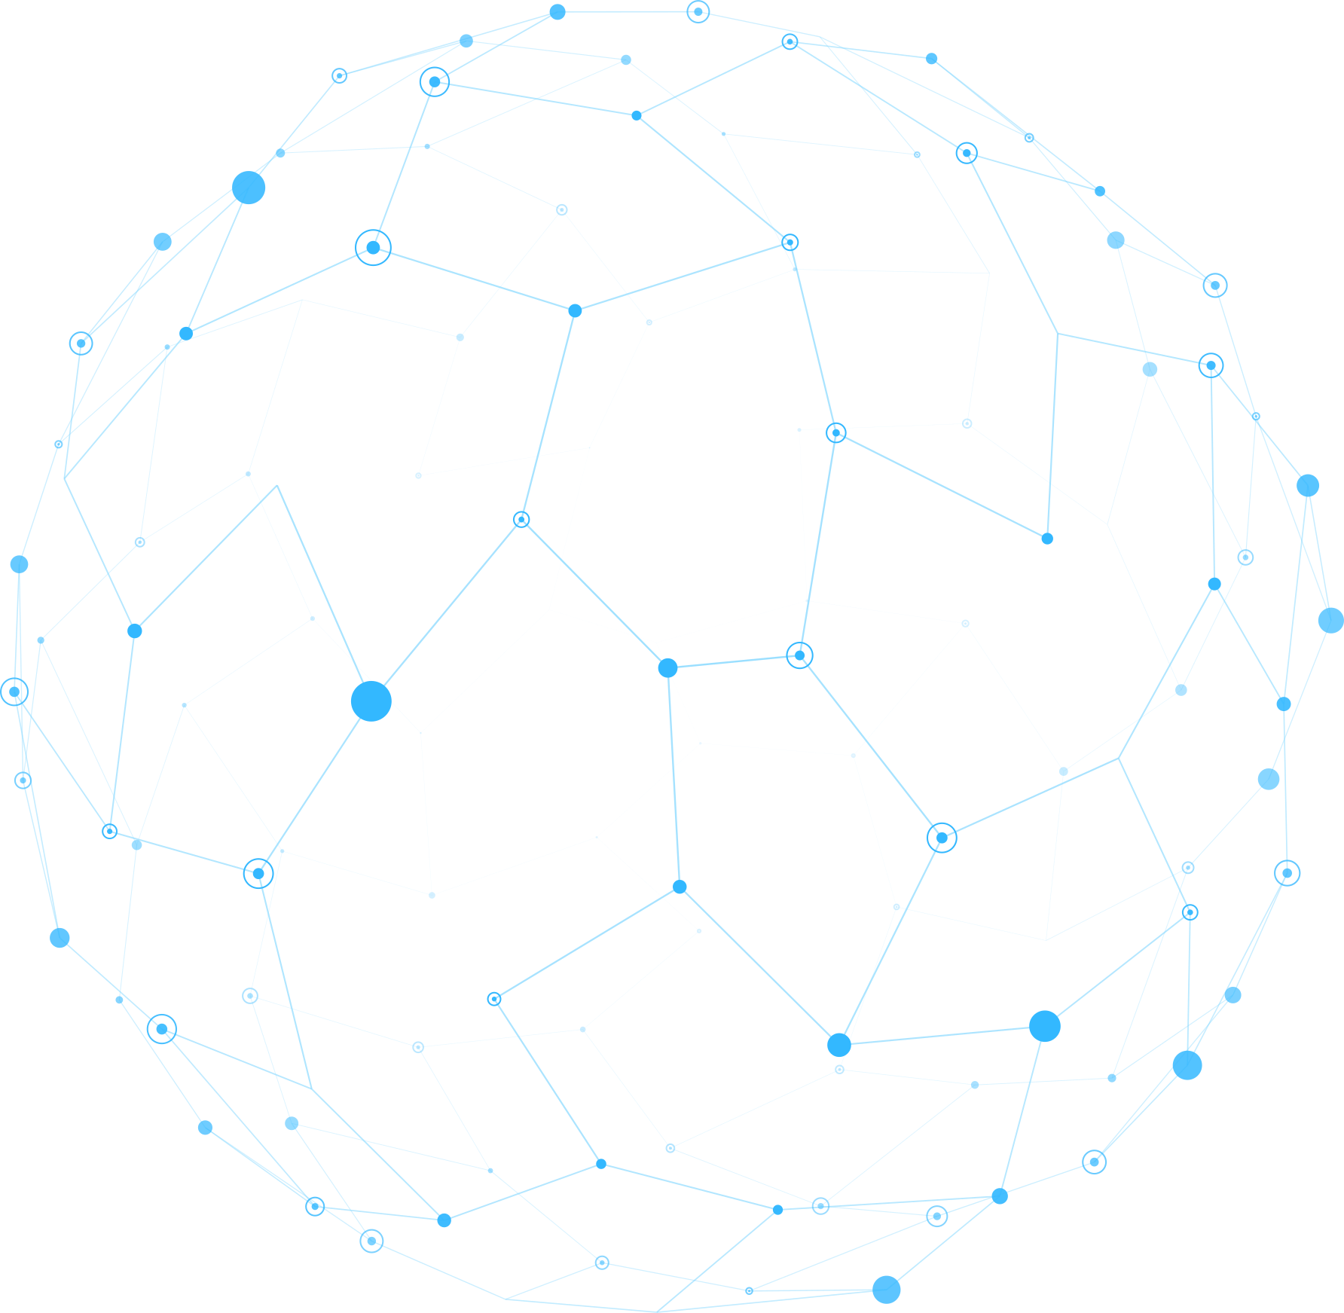

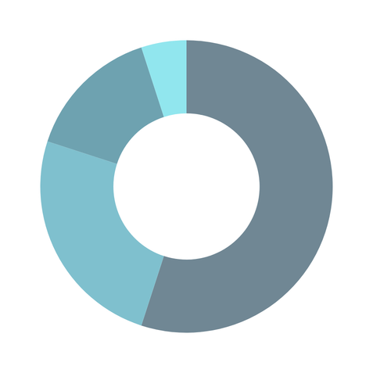
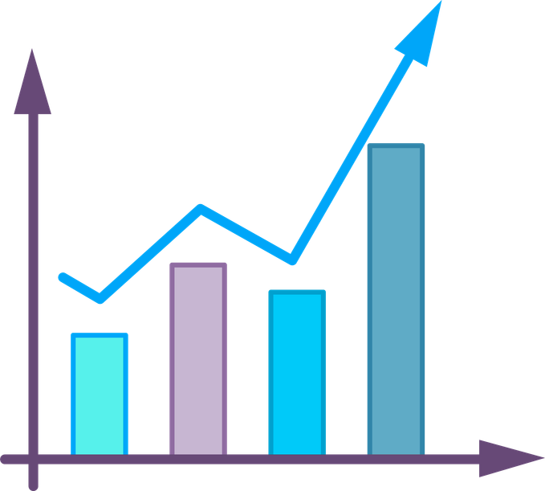
Shark Attacks Data Set
5
GROUP - BSDS
Notes:
2

Slide 3
WHY STUDY SHARK ATTACKS?
Moving Beyond the Movie Myths to Data-Driven Truth
Shark attacks are one of the most sensationalized natural phenomena in history. Media narratives focus on "monsters," But what if the data tells a completely different story?
Questions to Think About
  Are shark attacks actually increasing over time, or just being reported more?
  Which shark species are truly dangerous—and which are misunderstood?
  Is a shark attack usually fatal, or do most people survive?
  Which human activities put us at the highest risk?
  Has the danger changed over the last 100+ years?
Our ultimate goal: To replace fear with facts, showing that risk is determined by human context and location more than the shark's behavior.
Sharks are not the story-our interaction with them is

Slide 4
The Data Foundation: Global Shark Attack File
Source, Structure & 117 Years of Global Data | 1900-2017
Dataset Overview
5,409
117
50+
Total Records
Years of Data
Countries Covered
Confirmed shark attack incidents
1900 through 2017
Global geographic scope
Key Statistics
Attack Outcomes
Victim Demographics
  Non-Fatal: 4,204 (77.7%)
  Fatal: 1,205 (22.3%)
  Male: 4,326 (80%)
  Female: 569 (10.5%)
Top Regions
  USA: 2,030 (37.5%)
  Australia: 1,147 (21.2%)
  South Africa: 541 (10%)
Notes:
5

Slide 5
Understanding Our Variables
Breaking Down the 20 Columns of Attack Information
Temporal & Geographic
Victim Demographics
Which is the Most used variable under analysis?
Sex: Standardized (M / F / Uk)
The categorical Variable, Fatal
Year/Time: 117 years of data (1900–2017)
Age: Numeric values and Age Groups
Outcome & Species
Incident Characteristics
Fatal (Y/N): Binary status (1 = Fatal, 0 = Non-Fatal)
Type: Unprovoked vs. Provoked incidents
Species: Standardized into 15 primary shark groups
Activity: Categorized (Surfing, Swimming, Diving, etc.)
Injury: Qualitative description of the encounter
  names(df_updated)
  [1] "year" "type" "regions" "area"
  [5] "location" "activity" "sex" "age"
  [9] "injury" "fatal_y_n_" "time" "species“
  [13] "investigator_or_source" "case_number_1" "fatal_y_n" "age_num“
  .
  [17] "age_group" "species_group" "activity_group" "time_group"
Notes:
6

Slide 6
Salvage Operation: Preparing Data for Analysis
The 8-Step Cleaning
  Structural Cleanup: Removing irrelevant columns and fixing headers
  Variable Standardization: Normalizing Sex, Fatal Status, Age, and Species
  Final Processing: Handling temporal data and encoding
Challenge Identified | Solution Designed
The Problems We Found
  Messy Naming: Mixed case, special characters, and spaces in column headers
  Inconsistent Values: "M" vs "Male," "20s" vs "25," and 1,550 raw variants for shark species
  Missing Data: 67% of species unknown; age/time missing in significant records
  Redundancy: Useless web metadata (URLs/PDFs) and duplicate ID columns
Impact: Transformed 5,409 messy records into a clean, categorical dataset ready for statistical modeling.
Notes:
7

Slide 7
Data Cleaning: R samples
#Removing unnecessary columns
df_updated <- df[, !(names(df) %in% c("href","pdf","Date","Case.Number.2","original.order"))]
#Removing invalid data
df_updated <- df_updated[!is.na(df_updated$year) & df_updated$year >= 1900, ]
#Standardising column names
names(df_updated) <- tolower(names(df_updated))
names(df_updated) <- gsub("\\.+", "_", names(df_updated))
#Cleaning categorical data
df_updated$sex <- tolower(trimws(df_updated$sex))
df_updated$sex[df_updated$sex %in% c("m", "male")] <- "Male"
df_updated$sex[df_updated$sex %in% c("f", "female")] <- "Female"
df_updated$sex[df_updated$sex == "" | is.na(df_updated$sex)] <- "Unknown"
Notes:
9

Slide 8
Data Cleaning: From Raw Chaos to Analysis
Steps 1–5: Structural & Core Variable Standardization
01
02
03
Structural unique defining
Feasible Headers
Temporal Filtering
Removed redundant metadata (URLs, PDFs) and duplicate ID columns. Kept Case Number 1 as the primary unique identifier for all 5,409 records.
Converted all column names to snake_case (lowercase_with_underscores). Removed periods and trailing spaces to prevent programming errors.
Filtered to records from 1900–2017 only. Removed invalid/null years to ensure a reliable 117-year trend analysis.
04
05
Sex & Gender Normalization
Numeric Conversion (Fatal Status)
Consolidated "M", "male", "F", and "female" into three clean categories: Male (80%), Female (10.5%), and Unknown.
Transformed text ("Yes"/"No") into Binary Numeric (1 / 0). Enables advanced statistical risk modeling and survival rate calculations.
Notes:
8

Slide 9
Data Cleaning: Contextual Logic & Outcome
Steps 6–9: Behavioral Cleaning & The Survival Baseline
Age Grouping Logic
Geographic & Activity Refinement
Extracted strings (e.g., "mid-20s" → 25).
Created life-stage bins: Child, Teen, Adult, and Old.
Country Fix: Resolved the "Region vs. Country"
Species Standardization
Activity Consistency
Grouped 1,550+ raw text variants into 15 standardized shark groups.
Various entries has the same intention with different terminologies
(ex. diving/scuba/free diving/snorkel) ← Diving
Key Insight: Survival is the norm; the "Killer Shark" narrative is a statistical outlier.
Notes:
9

Slide 10
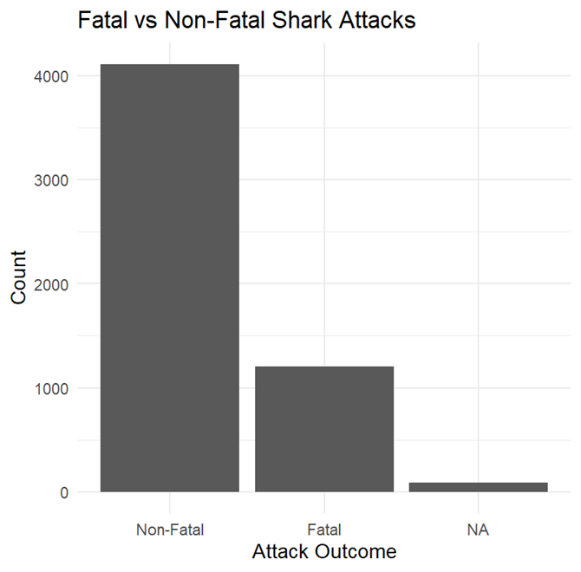
The Good News: Shark Attack Survival Rates
77.7% of Victims Survive | 22.3% Fatality Rate
The Bottom Line
Key Insight
Out of 5,409 documented shark attacks from 1900-2017:
Despite media sensationalization portraying sharks as killers, the survival rate is reassuring. Most shark encounters do not result in death.
  Non-Fatal: 4,204 attacks (77.7%)
  Fatal: 1,205 attacks (22.3%)
What This Means
Roughly 4 out of 5 shark attack victims survive. This baseline statistic is critical to understanding the rest of our analysis.
Why This Matters for Context
This 77.7% survival rate will be our baseline. All subsequent analyses will examine what factors influence whether someone falls into the 77.7% (survivors) or 22.3% (fatal cases).
Notes:
10

Slide 11



The Paradox: Rising Attacks, Falling Deaths
117 Years of Data Reveals a Surprising Trend (1900–2017)
The Story in Three Lines
Non-Fatal Attacks (Up)
Fatal Attacks (Flat)
Fatality Rate (Down)
Rising exponentially since 1960. Current levels reach 100–200+ incidents per year.
Remarkably stable at 5–30 deaths per year, despite a massive surge in ocean recreation.
Dropped from ~30% in the early 1900s to under 20% today.
Why the Paradox Exists
1. The Human Factor (Increased Exposure)
2. The Medical Factor (Improved Outcomes)
  Post-1960s boom in surfing, scuba diving, and beach tourism
  More humans in the water = more encounters (Not more aggressive sharks)
  Modern emergency response, trauma surgery, and antibiotics
  Fast helicopter evacuations from remote beaches
Key Takeaway: Sharks aren't attacking more because they are more dangerous; we are simply sharing their habitat more often , but our ability to save lives has outpaced the risk.
Notes:
11

Slide 12
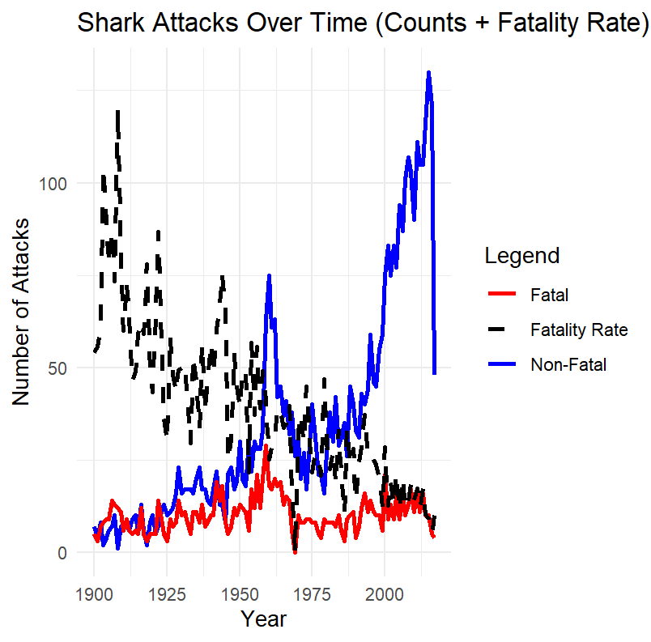
Graphical Representation of the Attacks
THE CORE FINDING: More Encounters,
Fewer Deaths
  Non-Fatal Attacks (Blue Line): Exponential Rise
  Significant surge starting around 1960.
  Fatal Attacks (Red Line): Stable/Flat
  Despite the massive increase in total encounters, the number of deaths has remained relatively constant over 117 years.
  Fatality Rate (Dashed Black Line): Sharp Decline
  The percentage of attacks that result in death has dropped dramatically from early 1900 highs to modern lows.
Notes:
12

Slide 13
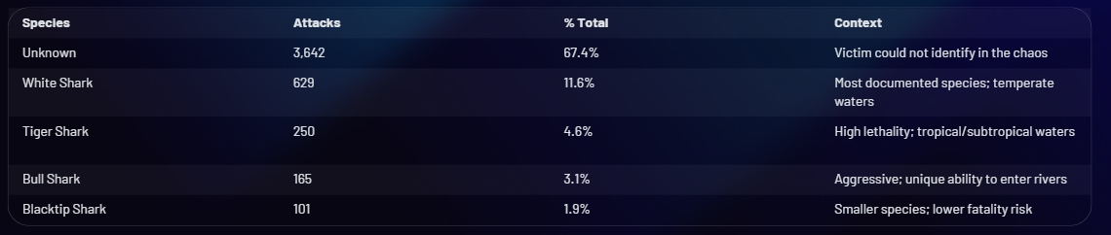
Which Sharks Attack?
The Big Three & The Unknown
Top Identified Species vs. The Mystery of the 67%
Key Analysis Points
The 67% Identification Gap
Frequency vs. Lethality
Regional Specialists
Most shark encounters happen in seconds. Water turbidity, adrenaline, and low visibility mean that 2 out of 3 sharks remain unidentified, making total "known" species data a sample rather than a complete picture.
The White Shark leads in total attack volume (629), but Tiger and Bull sharks often record higher fatality rates per encounter. This suggests that while Great Whites are more commonly encountered, Tiger and Bull sharks may be more dangerous when an interaction occurs.
White sharks dominate incidents in California, South Africa, and Australia, while Tiger and Bull sharks represent the primary threat in tropical estuaries and murky coastal waters.
Notes:
13

Slide 14



Your Activity Determines Your Risk
Frequency vs. Severity | Why Behavior Matters More Than Species
Activity
Frequency
Fatality Rate
Risk Profile
Surfing
Highest
12-15% (Low)
High Exposure / High Survival
Swimming
High
25-30% (Med)
High Exposure / Moderate Risk
Fishing
Medium
30-35% (High)
Remote Locations / High Danger
Boating
Low
40-50% (High)
Compound Risk (Drowning + Attack)
Disaster
Extreme
90-100% (Max)
Shipwrecks / Universal Fatality
Critical Insights
The Surfer Paradox
Context is King
Fatal Combination
Surfing has the highest number of attacks but the best survival rate. This is due to surfers usually being in groups, in daylight, and having boards that provide buoyancy/protection after a bite.
Swimming and Fishing carry higher risks because victims are often more isolated, deeper in the water column, and further from immediate medical help compared to beach-front surfers.
The 90%+ fatality rate for "Disaster" (shipwrecks/crashes) proves that environmental vulnerability and lack of rescue infrastructure determine death more than the shark's behavior itself.
Notes:
14

Slide 15
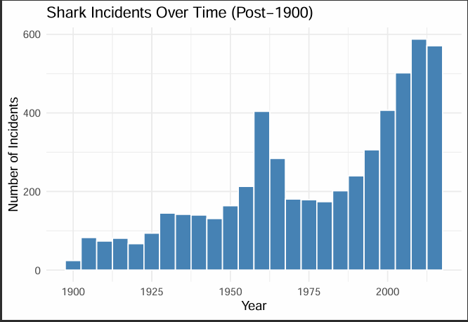
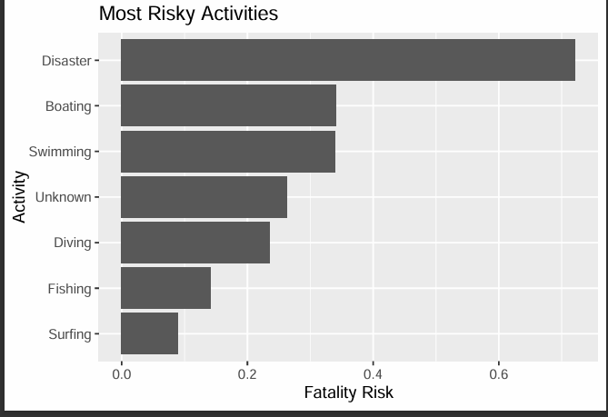
INCIDENTS & CAUSE
1. TIME-TREND ANALYSIS
  Growth: Exponential increase in recorded incidents post-1975.
  Paradox: Higher incident counts reflect increased human ocean participation, not more aggressive sharks.
2. ACTIVITY FATALITY RISK
  Extreme Risk: "Disaster" (shipwrecks/air crashes) carries a ~75% fatality rate.
  Mid-Range Risk: Boating and Swimming show moderate lethality (~35%).
  Low Risk: Surfing, despite high exposure, has the lowest fatality risk (<10%).
3. THE FATALITY FORMULA
  Risk = (Severity of Injury) / (Speed of Emergency Response)
  Note: Proximity to medical aid is the primary driver of survival in modern records.
Notes:
16

Slide 16
Testing using Chi-Square
1
Activity vs Fatality:
chi_activity <- chisq.test(table_activity)
Species vs Fatality
2
chi_species <- chisq.test(table_species)
3
Region vs Fatality
chi_region <- chisq.test(table_region)
Notes:
16

Slide 17
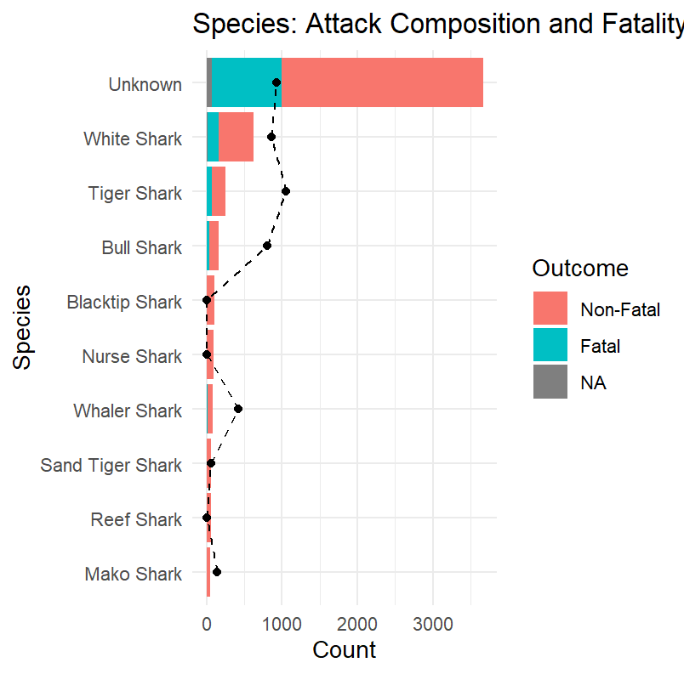
SPECIES ANALYSIS: POINT-INFERENCE
1. UNKNOWN DOMINANCE
Over 3,500 records are unidentified; conclusions rely on a minority sample.
2. VOLUME LEADER
White Shark is the most documented and identified species.
3. LETHALITY GAP
Tiger and Bull sharks show higher fatal proportions relative to their total volume.
4. LOW-THREAT SPECIES
Blacktip, Nurse, and Reef sharks show near-zero fatalities.
5. OUTCOME GAPS
"NA" segments exist where even survival status is unrecorded.
Notes:
16

Slide 18
The Deeper Story: Surprising Findings & Critical Realities
Deconstructing the Paradoxes and Limitations of Shark Data
The Five Most Surprising Findings
1
The Fatality Paradox
Attacks are rising exponentially (1900: 5/yr vs 2017: 100+/yr), but fatality rates have collapsed (60% down to 20%). This is due to modern trauma medicine and helicopter rescue, not sharks becoming "nicer."
2
The 88% Male Ratio
Often cited as a biological preference, the data suggests it is "participation bias." As female ocean sports participation has increased, the attack gap has narrowed accordingly.
3
Frequency vs. Severity
Surfers face the highest absolute number of attacks but have the best survival rates. Conversely, shipwrecks and boating accidents are rare but carry catastrophic (80-90%) lethality.
4
The Great White Myth
While the White Shark leads in total counts, Bull and Tiger sharks often record higher fatality rates per encounter due to murky water habitats and more persistent predatory behavior.
5
The "Unknown" Majority
60% of all attack records do not identify the shark species. This means all "top species" rankings are based on a minority of the data and carry high uncertainty.
Notes:
15

Slide 19
Key Data Limitations
1
2
3
Geographic Reporting Bias
The 75% Empty Row Problem
No Denominator (No True Rate)
68% of data comes from USA, Australia, and South Africa. Developing nations are severely under-represented despite having massive coastal populations.
Historical records (pre-1950) are extremely sparse. The "spike" in modern attacks is partly due to better digital archiving, not just shark behavior.
We have incident counts, but we don't know how many millions of people were in the water. We cannot calculate "per capita" risk without this.
4
5
Survivorship Bias
Species Misclassification
Attacks on solo swimmers at night or in remote regions are often never witnessed or reported, meaning the data likely underestimates solitary/remote risks.
Identification is often extracted from vague text like "large gray shark," leading to potential errors in species-level risk analysis.
Notes:
16

